Slide 1
NETWORK INTRUSION DETECTION SYSTEM USING NEURAL NETWORKS, AIDED BY BLOCKCHAIN
BY:
ANANYA DUTTA- 1805011
ARISMITA BANERJEE- 1805021
ARKAPRABHA SAMANTA- 1805106
SAYANTANI BALA- 1805245
SCHOOL OF COMPUTER ENGINEERING
KALINGA INSTITUTE OF INDUSTRIAL TECHNOLOGY
BHUBANESWAR, ODISHA- 751024

Slide 2
CONTENTS
What is Blockchain
DeepRing Architecture
Blockchain implementation in Neural Network
Neural Networks
Project Implementation
Data Cleaning
Classification
Neural Network
Clustering
Feature Selection
Sequential Method
Blockchain in Neural Network
Blockchain Creation
Proof of Work Algorithm
Integration of Neural Network with Blockchain
Results and Discussions
Conclusion
Future Scope
References

Slide 3
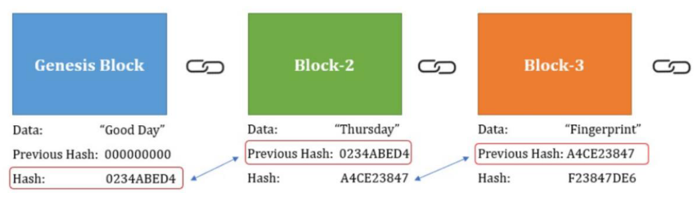
What is Blockchain?
It is a decentralized, distributed, shared, and immutable ledger, generally used to store records in form of blocks.
Each block contains the hash value of the previous block, and if any one of the hash value gets altered the next block will not accessible.
There is a consensus algorithm that verifies the transactions, thus making blockchain a highly secure system.

Slide 4
DeepRing Architecture
DeepRing combines CNN architecture with some features of blockchain. It is a closed chain of finite number of blocks. Each block represents a layer of the deep neural network.
Unlike a typical block in a blockchain, blocks of DeepRing contains the following information which helps in authenticating the block against tampering:
Hash of the current and previous block
Public keys of the neighborhood layers
Encryption keys of the current block
Parameters of the current and the next layer

Slide 5
Blockchain Implementation in Neural Network
The biggest security issue faced by neural network is that it is not tamper resistant. This will result in a wrong prediction output of the model, thus drastically reducing its efficiency, and posing a threat to the authenticity of the result.
The security of the neural network can be enhanced by blockchain in various ways:
Data Security: The data has to be secured by using blockchain, to provide a layer of anonymity and tamper resistance to the data used.
Secure the neural network model: implement each layer of the neural network model in a block of a blockchain- the deep ring model
Decentralize the neural network model, thus distributing the computational overhead.

Slide 6
Neural Networks
Neural networks are a progression of calculations that impersonate the activities of a human mind to perceive connections between huge measures of information. They are utilized in an assortment of utilizations in monetary administrations, from anticipating and advertising examination to extortion location and hazard evaluation.
An Artificial Neural Network is comprised of 3 segments:
Input Layer.
Hidden (computation) Layers.
Output Layer.
A neural network has numerous layers. Each layer plays out a particular capacity, and the complex the organization is, the more the layers are. That is the reason a neural network is additionally called a multi-layer perceptron.

Slide 7
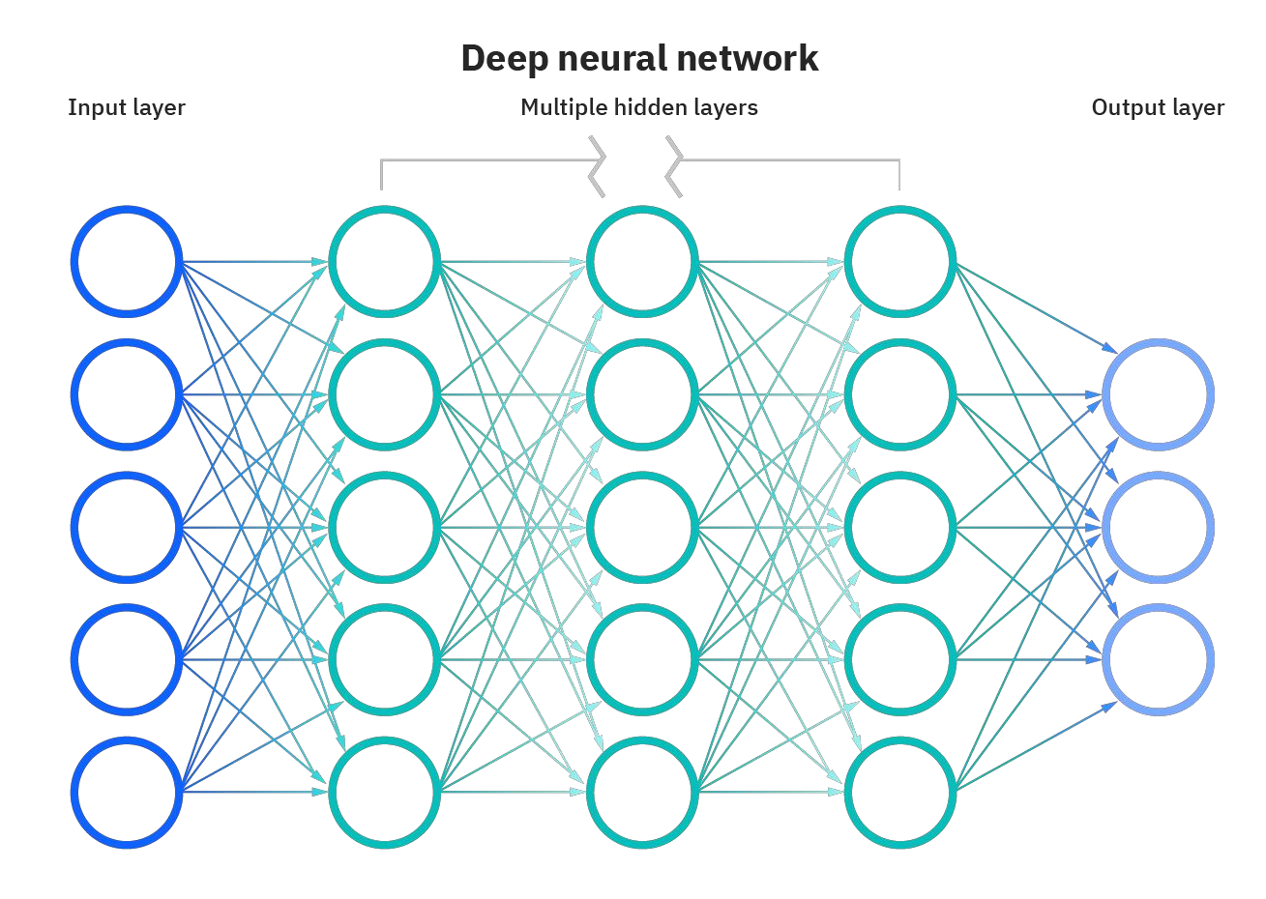
Figure 1. Deep Neural Network

Slide 8
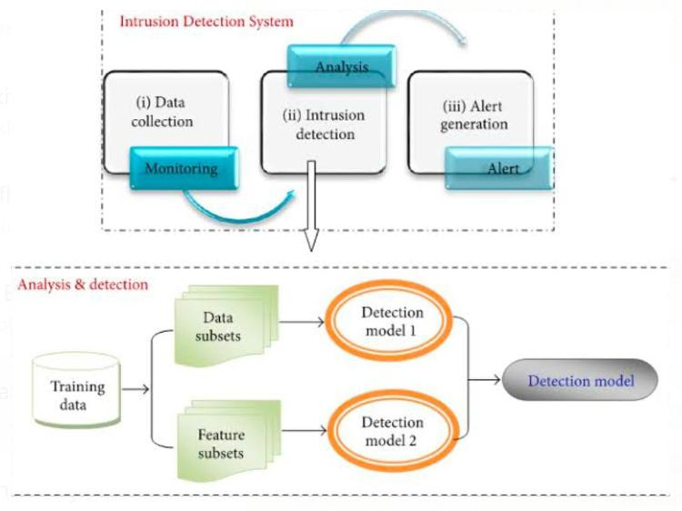
Project Implementation
Neural Network
Machine learning is the detailed examination of computational calculations that improve naturally by experience.
Methods which address the issues (Clustering and Classification) are implemented in IDS.

Slide 9
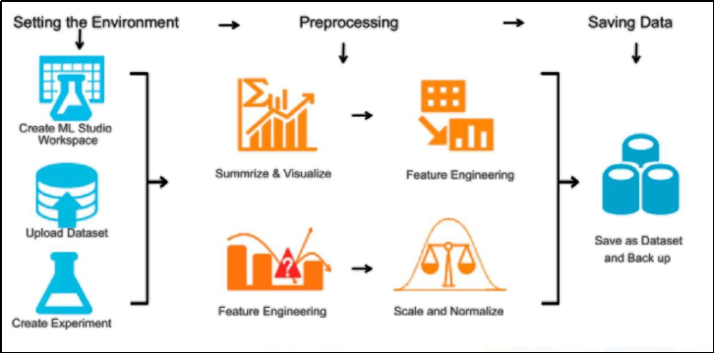
Data Cleaning
Preparing data for assessment by changing data that is misguided, unessential, replicated, etc.
Sorting out to intensify accuracy without deleting information.
In this project, Dataset gathered from a website. Divided into preparation (comprises 80% of the entire dataset )and test cases (20% of this dataset).
Consider uniqueness of features, if unique value equivalent to 1, we get most of the values similar. In correlation matrix ,any value near to 1 or 0 , drop those features.

Slide 10
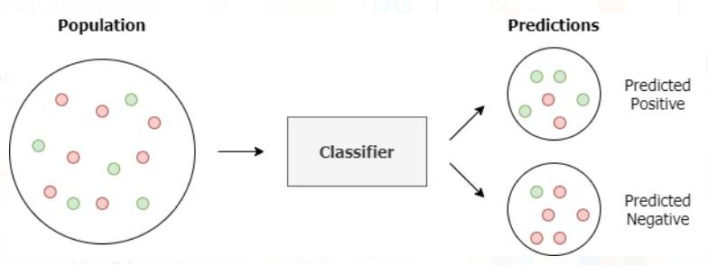
Classification
Each occasion of the dataset and group in classes.
Mapping of label class ‘id’ in two groups : Normal to ‘0’ and Anomaly to ‘1’.

Slide 11
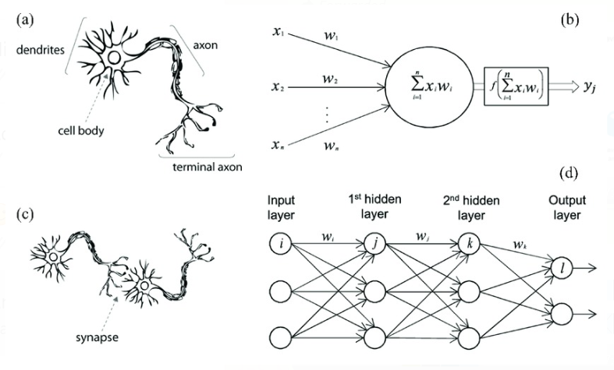
Neural Network
The utilization of neural associations for IDSs has been investigated by various analysts. Neural organizations give an answer for the issue of displaying the clients' conduct in abnormality discovery since they don't need any express client model[8]. Neural organizations for interruption discovery were first acquainted as an option with factual procedures in the IDES interruption recognition master framework to display. Specifically, the common grouping of orders executed by every client is learned.

Slide 12
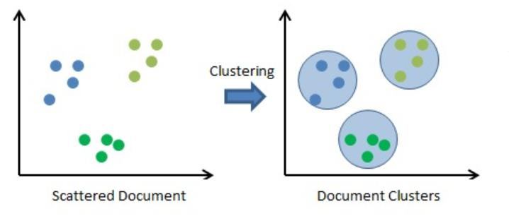
Clustering
Arranging comparative articles into various groups or clusters.
The attribute to group is often nearness according to some characterized distance measure.

Slide 13
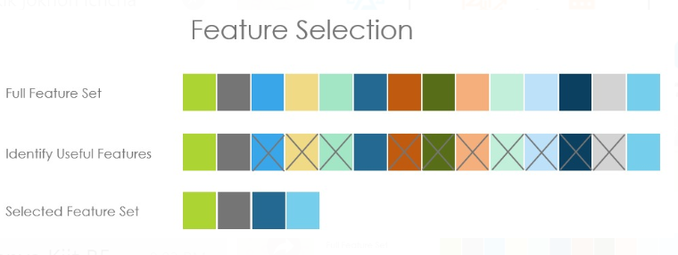
Feature Selection
A sub-set of all the features accessible from the information is chosen to be used in a learning calculation.
Extracted features can be positioned concerning their commitment.
Feature selection methods used: MLP Classifier and Decision Tree Algorithms.

Slide 14
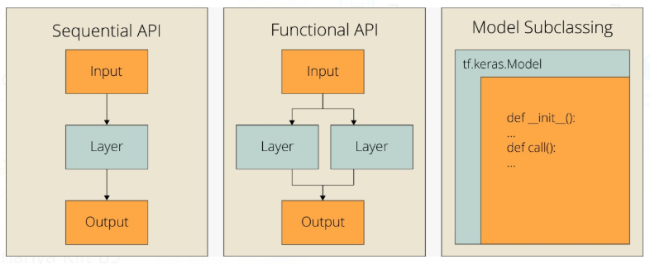
Sequential Method
Sequential method is used to achieve the output.
Sequential model is a plain heap of layers,en]ch layer consists of one info tensor and one yield tensor.
We got the best precision and accuracy result 98%.

Slide 15
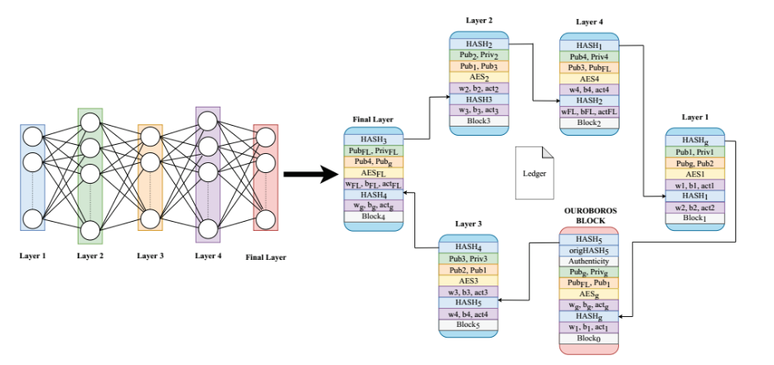
Blockchain in neural network
Neural network is not tamper resistant and it faces major security issue.
A slight change in one of the layers of the model will result in wrong prediction, and posing a threat to the result.
Creating empty list self chain to store the blockchain ring
Blockchain class
Constructor: Create empty list self chain to store the blockchain (ring).
Manage the chain of blocks.
Block must contain the hash value of the previous block. This provide blockchain’ s immutability.

Slide 16
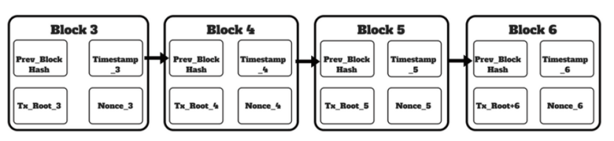
Blockchain Creation
Seeded with the genesis block.
Define methods new_block() and hash() in constructor.
We pass the parameters self and previous hash value in new_block() method.
We pass entire block to hash() method which is responsible to create a SHA-256 hash values.

Slide 17
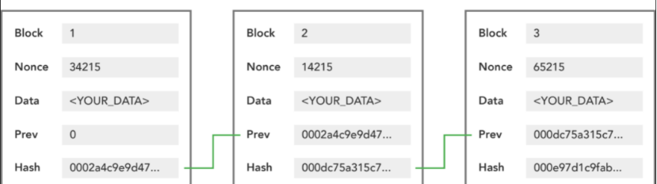
Proof of Work Algorithm
The algorithm defines
How each block is created and linked to blockchain
It ensures that the attached block is valid.

Slide 18
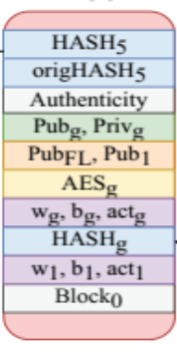
Integration of neural network with Blockchain
No. of blocks is one more than the no. of layers in neural network.
Each block pass their output to next layer.
Starting block named “ouroboros”.
Set of parameter from network fed to NN model. It invokes ouroboros block.
Check the authenticity of the query and call the first layer.
If the call is not authentic - then raise a concern to be checked for tampering.
If the call is authentic - Forwards the control flow of the program to next block.

Slide 19
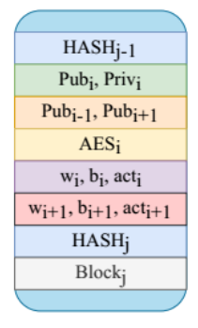
Integration of neural network with Blockchain
All the layers are visited.
Last block redirects the flow and forwards the control to ouroboros block.
Ouroboros determine that it is from last block , and authenticate.
Display the result- Intrusion detected or not.
Terminates the query
Wait for next query.

Slide 20
Results and Discussions
In this project, we have proposed a tamper-proof NN model, secured with blockchain. Here, we have trained an ANN model, secured with blockchain, having training accuracy 98% and validation accuracy 98%. In the future, we will extend the approach to make it efficient in terms of computational complexity and defend models against input image perturbation.
Attacking the model using the tampering attack:
If we apply the parameter tampering attack on NN architecture and the Blockchain architecture. For the case of Blockchain, tampering the parameters alerts the ouroboros block and informs the user.
Compromising a block by changing its input leads to the failure of the validation clause which indicates compromise. the proposed DeepRing model is fault free because of multiple authentication blocks such as validation/consensus and Hash functions. Therefore, we do not observe any reduction in performance for the proposed DeepRing. In our research, we observe that the proposed DeepRing yields 100% accuracy for detecting perturbations of input to a block.

Slide 21
Conclusion
In our project, we have created a model of network intrusion detection system,that uses neural network to detect the possible intrusion.
The accuracy of the model is taken to account as this is a sensitive work.We have striven to obtain great accuracy.
To further secure the Neural network using a deep ring mode, so it can be tamper-proof.
Each layer of the neural network is embedded in a block of blockchain and connected with each other using hash functions.
If there is any modification in blocks it will raises a concern. The IDS model is built to provide a precise prediction of the possible intrusion detected in the network.
Making it possible for the user to take any actions regarding the intervention of the threat in network.

Slide 22
Future Scope
Currently, the model built only detects the intrusion in the network, but doesn’t recognize and display which type of intrusion has occurred. Hence, the project can be scaled to classify and output the type of intrusion that has happened. The knowledge of the type of intrusion that took place can be used to reduce the response time and handle the situation accordingly. The software can be improved by equipping it with administrator control.The neural network in our project has been built using previously collected data that are not up-to-date as time goes by, and is currently not able to learn from experience.
Thus, we can incorporate the ability of learning from experience into our model thus making it more up-to-date and robust. Expanding on this idea, we aim to develop a complete Intrusion Detection and Management Software, secured by Blockchain, an integrated system, which provides one-stop and tamper-proof solution for protecting the network as well as provides options for customizing the IDS to some extent.

Slide 23
References
https://citeseerx.ist.psu.edu/viewdoc/download?doi=10.1.1.685.626&rep=rep1&type=pdf
https://ranger.uta.edu/~dliu/courses/cse6392-ids-spring2007/papers/NISTIntrusionDetection-2001.pdf
https://www.colleaga.org/sites/default/files/12-55-blockchain-based-approachfinal.pdf
https://medium.com/@vanflymen/learn-blockchains-by-building-one-117428612f46
Denning, D. E. (1987). An intrusion detection model. IEEE Transactions on Software Engineering, SE- 13:222-232.
Fox, K. L., Henning, l:t. 1~., l~eed, J. H., and Simonian.R. (1990). A neural network approach towards intrusion detection. In Proceedings of the 13th ,V~ltional Computer Security Conference, 125-134.
https://www.sisense.com/glossary/data-cleaning/
Debar, H., Becker, M., and Siboni, D., ”A Neural Network Component for an Intrusion Detection System”, IEEE Computer Society Symposium on Research in Security and Privacy, Los Alamitos, CA, pp. 240–250, Oakland, CA, May 1992.

Slide 24


